Slide 1
Operating Systems
Chapter 6d
Process Synchronization
Hammad Afzal
hammad.afzal@mcs.edu.pk
Department of Computer Software Engineering
National University of Sciences and Technology

Slide 2
Process Synchronization
Atomic Transactions

Slide 3
Atomic Transactions
System Model
Log-based Recovery
Checkpoints
Concurrent Atomic Transactions

Slide 4
System Model
Assures that operations happen as a single logical unit of work, in its entirety, or not at all (atomic)
Related to field of database systems (also applicable and useful for operating system)
Challenge is assuring atomicity despite computer system failures

Slide 5
System Model
Transaction - collection of instructions or operations that performs single logical function
Here we are concerned with changes to stable storage – disk
Transaction is series of read and write operations
Terminated by commit (transaction successful) or abort (transaction failed due to some logical error or system failure) operation
Aborted transaction must be rolled back to undo any changes it performed

Slide 6
Types of Storage Media
Volatile storage – information stored here does not survive system crashes
Example: main memory, cache
Nonvolatile storage – Information usually survives crashes
Example: disk and tape
Stable storage – Information never lost
Not actually possible, so approximated via replication or RAID to devices with independent failure modes
Goal is to assure transaction atomicity where failures cause loss of information on volatile storage

Slide 7
Log-Based Recovery
Record to stable storage information about all modifications by a transaction
Most common is write-ahead logging
Log on stable storage, each log record describes single transaction write operation, including
Transaction name
Data item name
Old value
New value
<T_{i} starts> written to log when transaction T_{i} starts
<T_{i} commits> written when T_{i} commits

Slide 8
Log-Based Recovery
Log entry must reach stable storage before operation on data occurs
Two physical writes are requested for every logical write requested.
More storage is required.

Slide 9
Log-Based Recovery Algorithm
Using the log, system can handle any volatile memory errors
Undo(T_{i}) restores value of all data updated by T_{i}
Redo(T_{i}) sets values of all data in transaction T_{i} to new values
Undo(T_{i}) and redo(T_{i}) must be idempotent
Multiple executions must have the same result as one execution

Slide 10
Log-Based Recovery Algorithm
If system fails, restore state of all updated data via log
If log contains <T_{i} starts> without <T_{i} commits>, undo(T_{i})
If log contains <T_{i} starts> and <T_{i} commits>, redo(T_{i})

Slide 11
Checkpoints
In principle, in case of system failure, we need to see entire log to find which transactions to be redone and undone.
Two drawbacks of this approach:
Searching process is time consuming.
Most transactions have already updated the data value.
Log could become long, and recovery could take long.
Checkpoints shorten log and recovery time.

Slide 12
Checkpoints
Checkpoint scheme:
Output all log records currently in volatile storage to stable storage
Output all modified data from volatile to stable storage
Output a log record <checkpoint> to the log on stable storage

Slide 13
Checkpoints
Now recovery only includes Ti, such that Ti committed prior to checkpoint.
The <Ti commits> record appears in log before checkpoint.
Any modifications written by Ti must be written to stable storage. Thus no need to redo.

Slide 14
Concurrent Transactions
Must be equivalent to serial execution – serializability
Could perform all transactions in critical section
Inefficient, too restrictive
Concurrency-control algorithms provide serializability

Slide 15
Serializability
Consider two data items A and B
Consider Transactions T₀ and T₁
Execute T₀, T₁ atomically
Execution sequence called schedule
Atomically executed transaction order called serial schedule
For N transactions, there are N! valid serial schedules

Slide 16
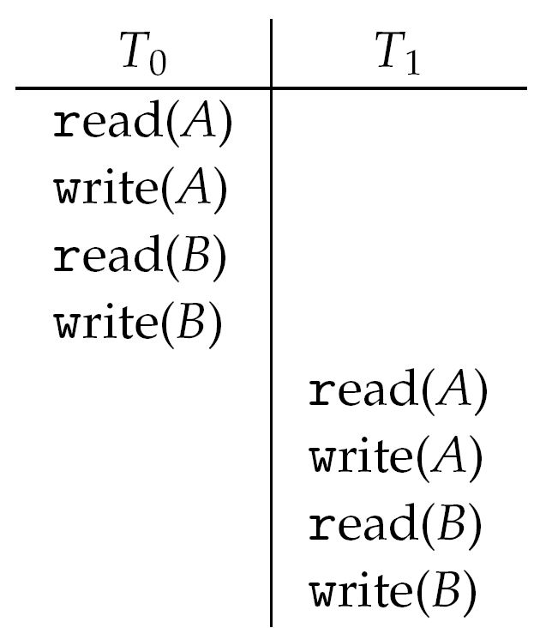
Schedule 1: T0 then T1

Slide 17
Nonserial Schedule
Non-serial schedule allows overlapped execute
Resulting execution not necessarily incorrect
Consider schedule S, operations O_{i}, O_{j}
Conflicting Operation if access same data item, with at least one write
If O_{i}, O_{j} consecutive and operations of different transactions & O_{i} and O_{j} don’t conflict
Then S’ with swapped order O_{j} O_{i} equivalent to S
If S can become S’ via swapping nonconflicting operations
S is conflict serializable

Slide 18
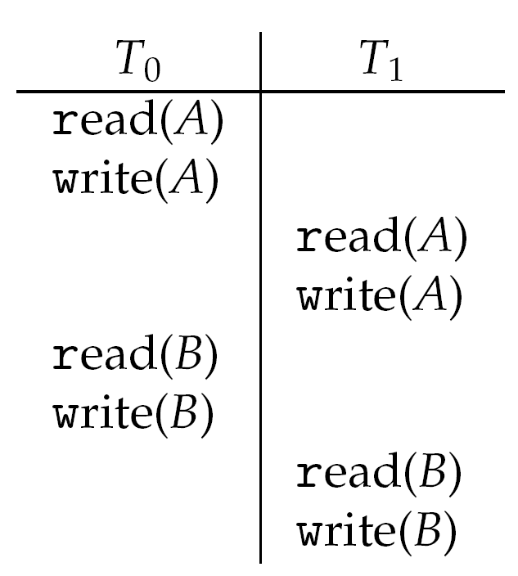
Schedule 2: Concurrent Serializable Schedule

Slide 19
End of Chapter 6

